Slide 1
Focused SNE Dimension Reduction Algorithm
Rafael Baez, Sanuj Kumar, Tuan Le

Slide 2
Motivations
Dimensionality reduction reduces complexity
Computation is cheaper
Models are more interpretable
Existing algorithms all differ in capabilities and effectiveness at preserving information.
Complete preservation is impossible, so we’ll focus on just local structure.

Slide 3
Literature Review - Stochastic Neighbor Embedding
Geoffrey Hinton and Sam Roweis 2002
Using asymmetric probabilities that a point i would pick point j as its neighbor, in both the high and low dimension space, the differences are minimized.
Cost function is defined with the Kullback-Leibler divergence, a measure of how one probability distribution is different from another.
Notes:
Original Stochastic Neighbor Embedding (SNE) method.
Minimization through gradient descent method.
*CAPTION SNE Breast Cancer Dataset*

Slide 4
Literature Review - LAPS and GAPS
Interpretation of Structural Preservation in Low-Dimensional Embeddings Aindrila Ghosh, Mona Nashaat, James Miller, and Saikh Quader 2022
Local Approximation of Preserved Structure - Using the neighbors around a given point, determine if similar factors are present in both spaces.
Global Approximation of Projection Space - Using several points, each belonging to a different label, measure for globally preserved structure.
Notes:
Each dimension reduction method has their own metric, so they developed two new measures for local and global preservation of structures.

Slide 5
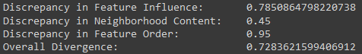
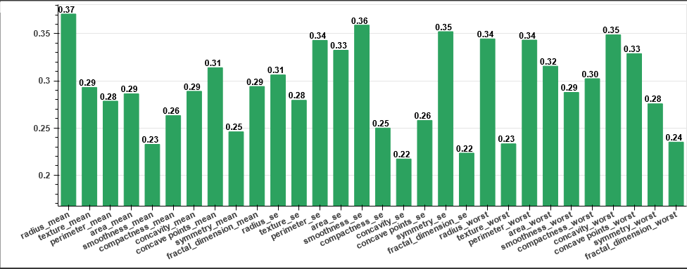
LAPS Measures
Notes:
Feature Influence Chart

Slide 6
Literature Review
Visualizing Data using t-SNE - Laurens van der Maaten, Geoffrey Hinton 2008
New implementation of SNE algorithm that performs better and is easier to optimize.
Step-By-Step Derivation of SNE and t-SNE gradient - Federico Errica 2020
Notes:
*CAPTION t-SNE MNIST Dataset*

Slide 7
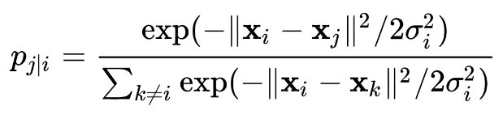
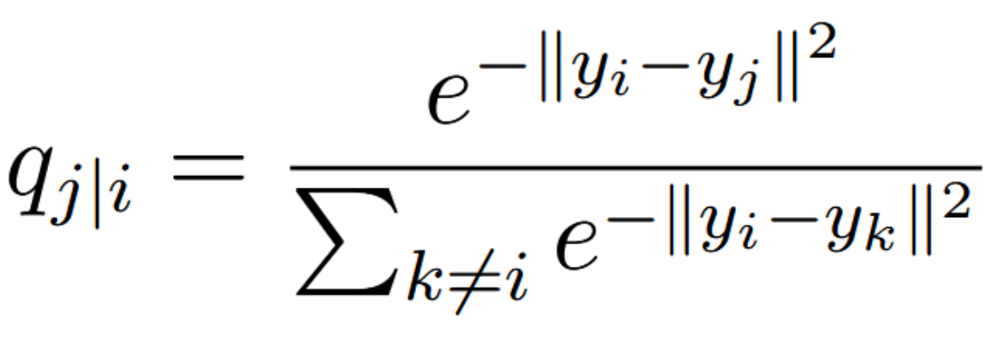
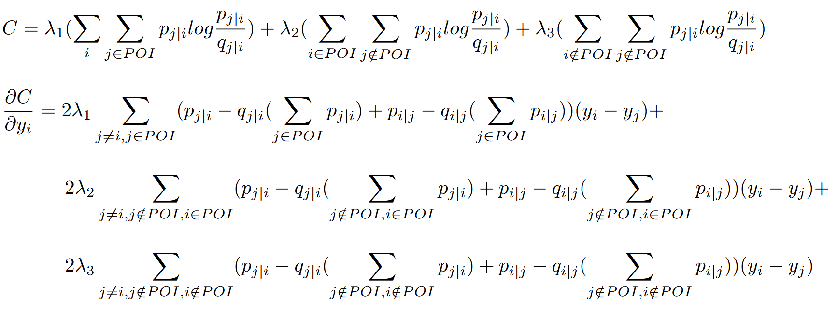
Problem Definition
Development of a dimension reduction algorithm that focuses on the preservation of local structure between given points of interest.
Given a set of N high-dimensional objects x₁,...,x_{N} and a subset of N, which contains points of interest POI, compute the following probabilities p_{ij} for all objects in N and q_{ij} for their respective counterparts in the low dimensional embedding:
Minimize the difference between both probability distributions according to the cost function:
Then return the embedding of the set in a lower dimension space which should have a focus on the neighborhood of the given POI.

Slide 8
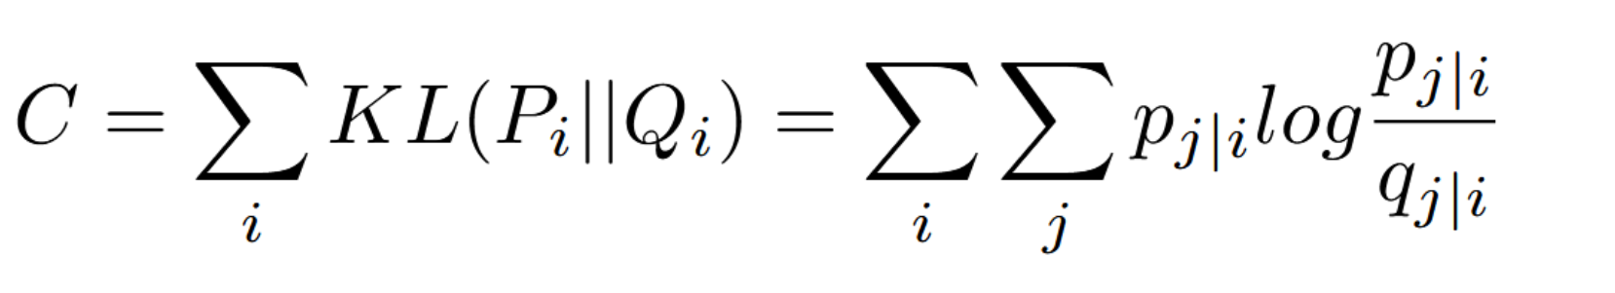
Solution
Original SNE algorithm traverses all points and takes all the probabilities equally into consideration.
Our proposed algorithm still traverses all points, but assigns a higher weight and cost to probabilities related to points of interest.
Notes:
Same gradient descent minimization.

Slide 9
Next Steps
Implementation:
Slow and steady
PyTorch
Experiments
Several datasets available online, but we can use the same datasets in the LAPS & GAPS paper.
Hyperparameter search for optimal lambda values, if any exist.

